Slide 1
Meeting Title
Presenter Name, Title, Company

Slide 2
Please check into the meeting at the entrance if you haven’t already
Has your company paid 2024 dues?
If you’re not sure, please be sure to check with an Officer at the entrance
Paid member companies are also available on our website for your easy reference

Slide 3

Article IV: Membership Eligibility:
Membership in any RLUG local chapter is open to anyone with a current, valid, Retail Link ID.
This membership is subject to the compliance of all rules and regulations of the Wal-Mart Stores, Inc. Supplier Agreement,
Retail Link Legal Agreement, and these by-laws.
Reasonable security measures must be taken at meetings to ensure that attendees are, in fact, eligible for attendance.
No Wal-Mart confidential information is to be shared with anyone other than authorized individuals.
These measures can include checking identification, issuing member badges, etc. as well as adherance to VICS Anti-Trust Guidelines.

Slide 4

As a courtesy to others, please silence your phone
If you need to take a phone call, please step outside

Slide 5
VICS Antitrust Guidelines
Don’t discuss Price or anything that directly or indirectly affects prices.
Don’t discuss what your company plans to do in geographic or product markets or describe in detail your relationship with particular customers or vendors.
No Bashing!

Slide 6
Retail Link Announcements – add as many slides as needed

Slide 7
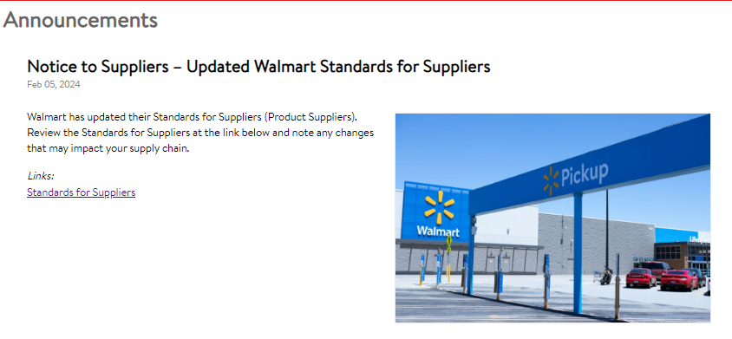

Slide 8

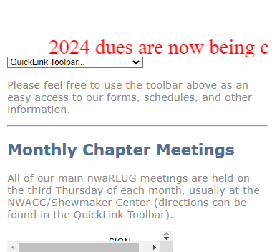
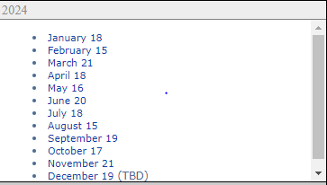

Slide 9
nwaRLUG Sub Group Calendar
Update with current sub group calendar – get from Eileen

Slide 10
Upcoming Events
Monthly Chapter Meetings
  Be sure to check our nwaRLUG.org website for:
  upcoming Chapter Meeting dates & agendas.
SubGroup Meetings
  Be sure to check our SubGroup Calendar on our website for dates and details
  www.nwaRLUG.org/SubGroups/Subgroup Schedules.xls

Slide 11

Are you receiving our nwaRLUG email communications?
Be sure to add us to your safe senders list within your email client

Slide 12

Text Your Questions – 479-366-3266
If you are not comfortable asking your question in front of everyone during the meeting, please feel free to text your question to: 479-366-3266
Any question sent via text will be asked on your behalf

